Slide 1


Reactive Extensions
Push your data
By
Grzegorz Jachimko

Slide 2
RX – the big picture
LINQ
Reactive Extensions
Task Parallel Library
.net platform - APM
Operating System

Slide 3
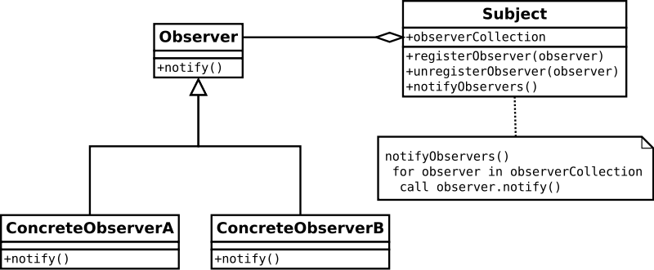
RX – it is all about the Observer
http://http://en.wikipedia.org/wiki/Observer_pattern

Slide 4
Observer in .net
Two basic interfaces:
interface IObserver<TSource>
{
void OnNext(TSource item);
void OnCompleted();
void OnError(Exception err);
}
Interface IObservable<TResult>
{
IDisposable Subscribe(IObserver<T> observer)
}
It is all about „push” vs „pull” model…

Slide 5
RX concurrency
Out of the box – RX is NOT using threads
(there are some exceptions though – Timer, Interval)
RX will execute code on any given thread
Wait! – this doesn’t sound right, does it?
Subscription thread – SubscribeOn
Observation thread – ObserveOn
IObservable<T> sequence = …;
sequence .SubscribeOn(IScheduler) .ObserveOn(IScheduler) .Subscribe()

Slide 6

Lets have a look at the details - IObservable
Simple interface - IDisposable Subscribe(IObserver)
Why bother with disposable?
How about…
Exception handling?
Completition?
Extensions methods!!!

Slide 7
Lets have a look at the details - IObserver
Yet another simple interface…
OnNext
OnCompleted
OnError
How do we create them?
Factory methods!!! – Return, Start, Create
Some other handy methods
Empty
Throw
Never
From events
From tasks
From async

Slide 8
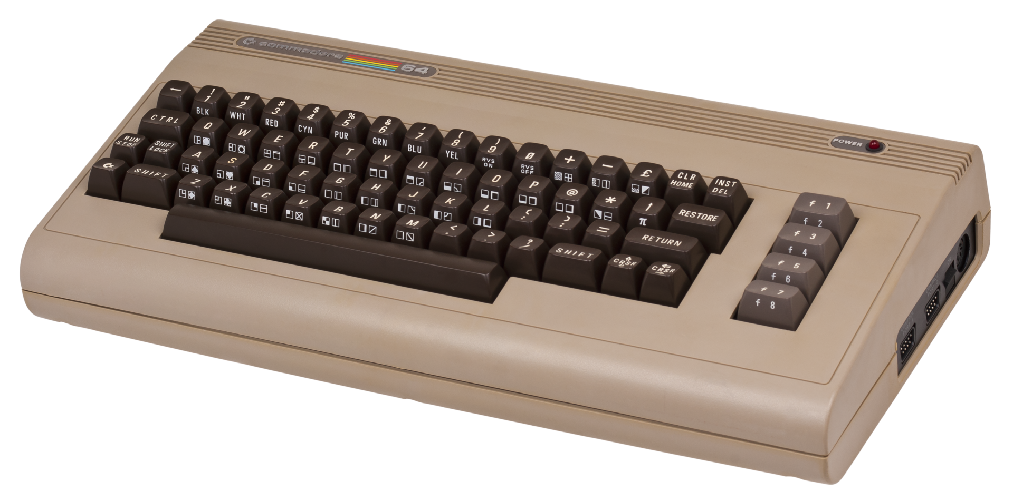
Demo!

Slide 9

I’ve heard something about Subjects…
What a subject is?
Subject types:
Subject<T>
ReplaySubject<T>
BehaviourSubject<>
AsyncSubject<T>
How and when to use them?

Slide 10
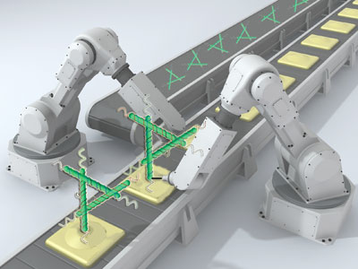
Sequence manipulation
It is almost as simple as with LINQ!
Where
Distinct / DistinctUntilChanged
Skip / Take
SkipWhile / SkipUntil / TakeWhile / TakeUntil
There is some extra flavour to:
Count, Min, Max, Sum, Average
I said almost like LINQ, because there are:
First, Last
Single

Slide 11
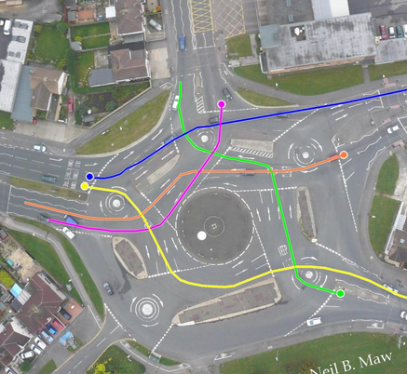
What if I want to aggregate?
Nothing fancy– use following:
Aggregate
Scan
Min / Max
MinBy / MaxBy
GroupBy

Slide 12

And there are also nested seqences
Sequence of a sequence
IObservable<IObservable<T>> what is this?
Let’s say – whenever I type a partial city name, I’d like to get instant auto suggestion of all matched cities…
This translates to:
P → Piła, Płock, Poznań, Polkowice, Poręba
Po → Poznań, Polkowice, Poręba
Poz → Poznań

Slide 13

How to understand it?
An image is worth 1.000 words…
Sequence is a horizontal line
Time moves to the right
Notification is one of:
OnNext = 0
OnCompleted = |
OnError = X
So:
0-0-0-| sequence completed with 3 elements
0-X sequence completed with error after producing value
-| empty sequence
--- sequence which didn’t complete nor produced anything

Slide 14
So going back to the example…
- - 0 - - - - - - - - - - - - - - 0- - - - - - - - - - - 0 - - - - -
(P) (Po) (Poz)
---------0-------0-------------0-----------------0-I
(Piła) (Poznań) (Polkowice) (Poręba)
--------0---------0-------0-I
(Poznań)(Polkowice)(Poręba)

Slide 15

What do I do with it?
Combine!
Merge
Switch
Amb
Zip
CombineLatest
Concat
StartWith

Slide 16
Yet another demo!

Slide 17
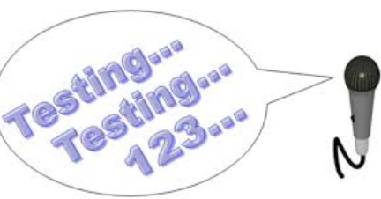
What about testing?
RX supports testing out of the box!
Install package Rx-Testing
Use TestScheduler
AdvanceBy
AdvanceTo

Slide 18
And short testing demo

Slide 19

Some control flow instructions
Using
Catch
Finally
Retry
OnErrorResumeNext
Deffer
Repeat
Delay
Timeout
Throttle

Slide 20
That’s pretty much, when it comes to basics….
Thanks for your attention!
If you have questions –
grzegorz.jachimko@rulefinancial.com

